Slide 1


Geographic Sales Territory Analysis
K. Hickman
10/30/2017
+
POWERED BY DOMO | exported 30 Oct 2017

Slide 2
Agenda
Territory Breakdown by County
Revenue Analysis
  Key Account Locations
  Geographic Centers of Activity
Revenue Analysis by State
Industry Analysis
Time Series Analysis
  North
  East
  South
Attachments/Addenda
  County List
  Domo Dataflows
+
POWERED BY DOMO | exported 30 Oct 2017

Slide 3
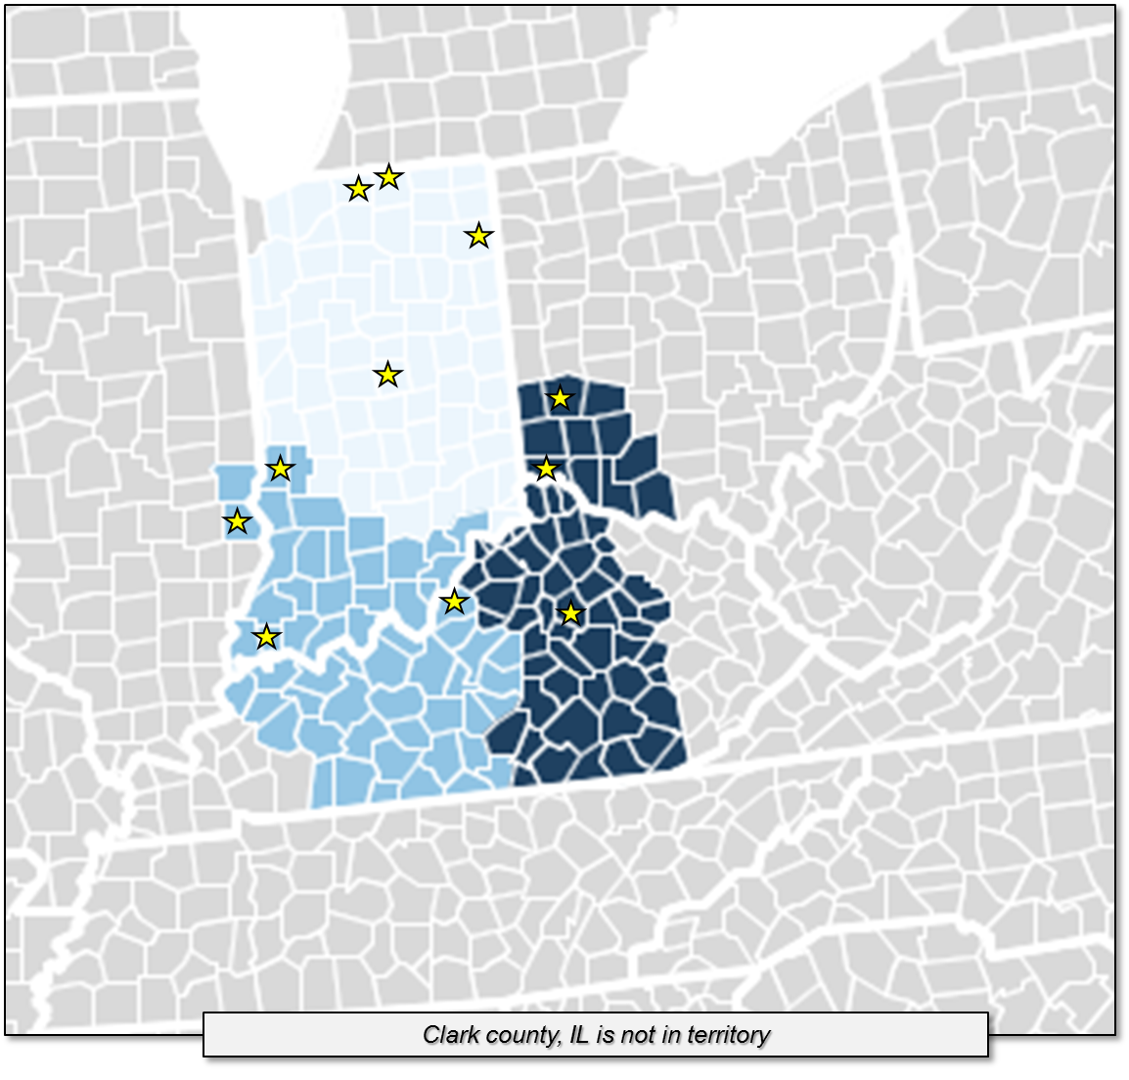
Territory Breakdown
North
Indianapolis
South Bend
Ft. Wayne
Elkhart (Goshen)
East
Dayton
Cincinnati
Lexington
South
Evansville
Terre Haute
+
POWERED BY DOMO | exported 30 Oct 2017

Slide 4

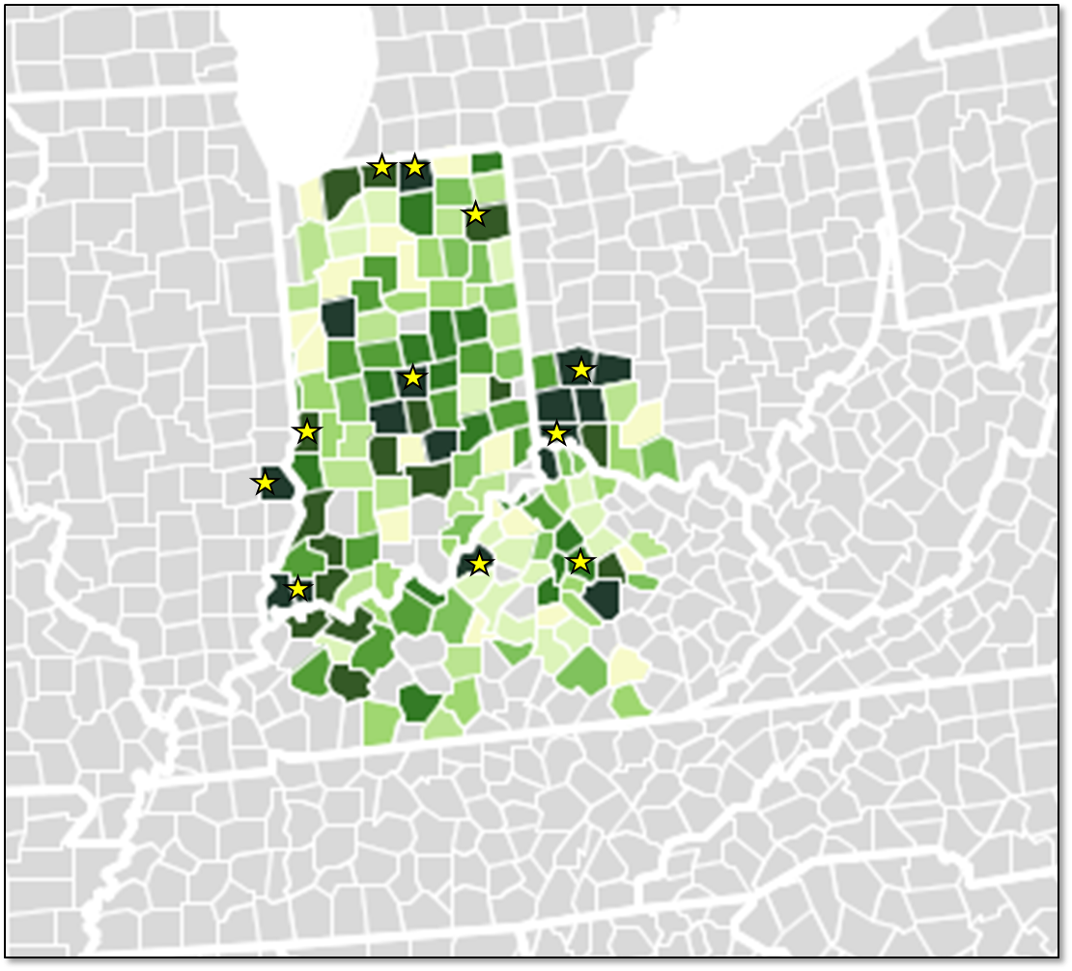
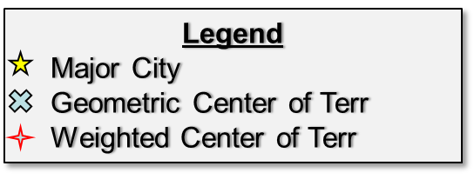
Geographic Regional Sales – Last 12 Months
North
Indianapolis
South Bend
Ft. Wayne
Elkhart (Goshen)
East
Louisville
Dayton
Cincinnati
Lexington
South
Evansville
Terre Haute
+
POWERED BY DOMO | exported 30 Oct 2017

Slide 5
Travel Distances
North
Start | End | Time
Indy | So. Bend | 3+ hrs
Indy | Ft. Wayne | 2.5 hrs
Indy | Columbus, IN | 2 hrs
South
Start | End | Time
Louisville | Evansville | 2 hrs
Louisville | Robinson | 3 hrs
Evansville | Robinson | 2 hrs
East
Start | End | Time
Cincy | Dayton | 1 hr
Cincy | Lexington | 1.5 hrs
Cincy | So. KY | 2.5 hrs
+
POWERED BY DOMO | exported 30 Oct 2017

Slide 6
Revenue Activity – Indiana (Last 12 Months)
North
Indy
Elkhart (Goshen)
Robinson, IL (Not pictured)
South
Evansville
+
POWERED BY DOMO | exported 30 Oct 2017

Slide 7
Revenue Activity - Kentucky (Last 12 Months)
East
Louisville
South Bend
Elkhart (Goshen)
South
Henderson
+
POWERED BY DOMO | exported 30 Oct 2017

Slide 8
Revenue Activity Ohio – Last 12 Months
East
Cincy
Dayton
+
POWERED BY DOMO | exported 30 Oct 2017

Slide 9
Agenda
Territory Breakdown by County
Revenue Analysis
  Key Account Locations
  Geographic Centers of Activity
Revenue Analysis by State (printout)
Time Series Analysis (Printout)
  North
  East
  South
Industry Analysis (Domo)
Attachments/Addenda
  County List
  Domo Dataflows
+
POWERED BY DOMO | exported 30 Oct 2017

